Slide 1



Dania Beach
Downtown Asset Management and Assessment
/
Project Team

Slide 2
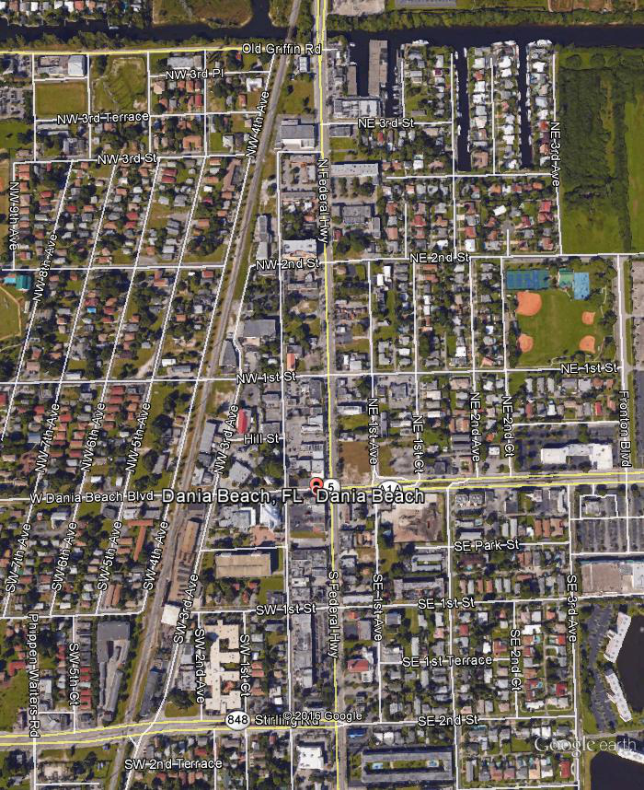
Limits of Study
Downtown Area
FEC Tracks to NE/SE 1st Ave, including both sides of Road
Stirling Rd to Griffin Rd.

Slide 3
Goals of Study
Identify City assets on the surface
Assess condition of those assets
Collect information on other assets
Identify maintenance needs
Identify areas for improvements

Slide 4
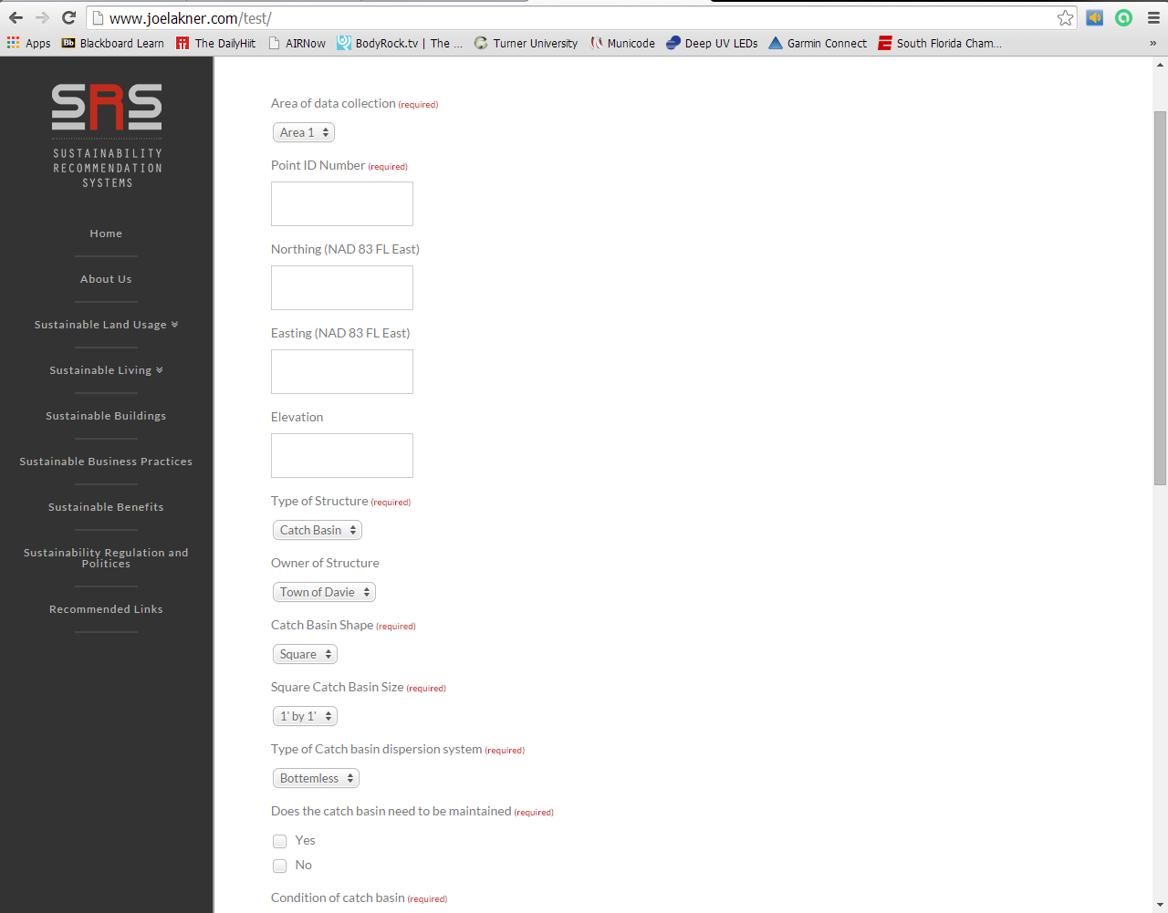

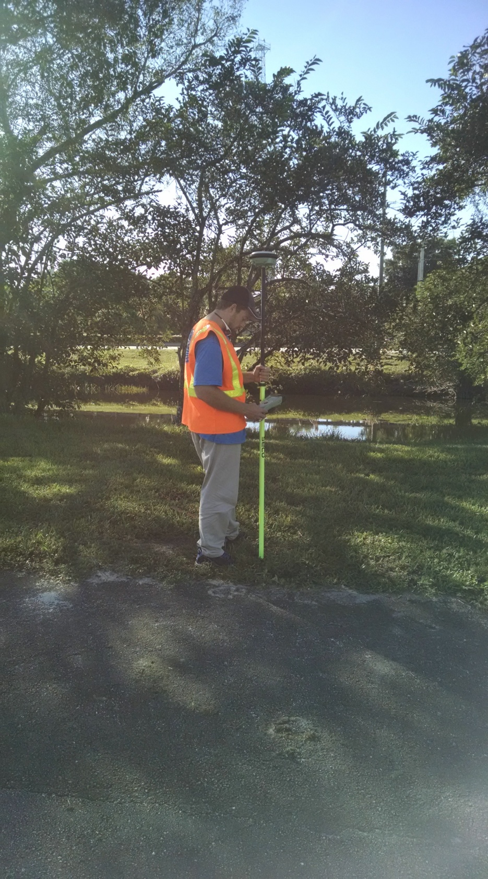
Created an on-line tool from phones with mobile RTK-GPS
Notes:
Data Collection system, is custom built for this, all data collection is done with RTK ( real-time Kinematic) GPS with sub-cm accuracy utilizing the FDOT Network Linked to completely interactive field data input is joelakner.com/test

Slide 5
What Data was gathered
Roadways,
Curb locations,
Sidewalk limits,
Street Signs,
Water Main (as defined by valve box locations),
Sewer Lines (as defined by manhole locations),
Service laterals and meters
Storm water catch basins,
Green Infrastructure,
Location of poles, street lights, and traffic devices

Slide 6
Assessment Rating System
Good
  No repair needed for 3 to 5 years
  This time could be extended after more data over time is collected.
Fair
  Repair could be needed in 1 to 3 years
Poor
  Repaired needed this year

Slide 7
Mapping Assets

Slide 8
Assets
Asset | Number |  | Asset | Number
Backflow DW | 35 |  | Manhole Elect | 12
Bike Lock | 5 |  | Manhole SS | 69
Bus Bench | 6 |  | Meter DW | 106
Catch Basin SW | 57 |  | Observation Well | 5
Cleanout SS | 26 |  | Pole Elect | 105
Control Box | 10 |  | Pole W\ Transformer | 16
Crosswalk Signal | 20 |  | Pull Box | 97
Curb | 87 |  | Reclaimed Water Box | 10
Curb Inlet | 20 |  | Sidewalk/Curb | 289
Do Not Enter | 10 |  | Sign | 68
Fire Zone | 1 |  | Stop Light Pole | 12
Riser | 4 |  | Stop Sign | 24
One Way | 2 |  | Street Light | 42
Bollard | 1 |  | Swale | 5
Electric Meter | 1 |  | Transformer | 1
Fiber Optic Riser | 8 |  | Trash Can City | 9
Fire Hydrant | 26 |  | Valve DW | 77
Fire Sprinkler | 1 |  | Valve Gas | 11
Irrigation Control | 8 |  | Yield | 1

Slide 9
Condition
Red Dots need work

Slide 11
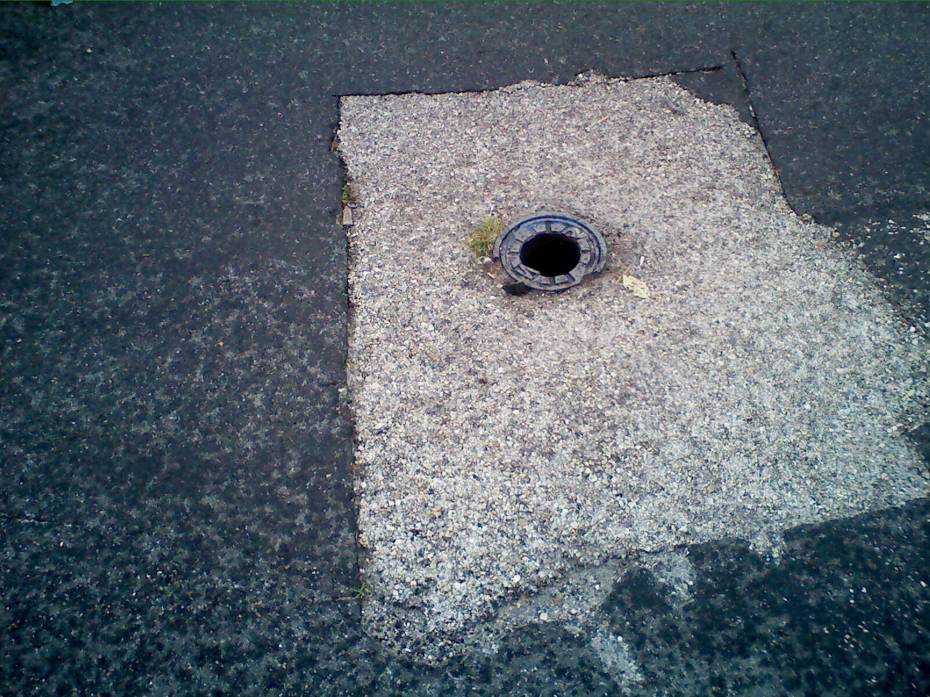
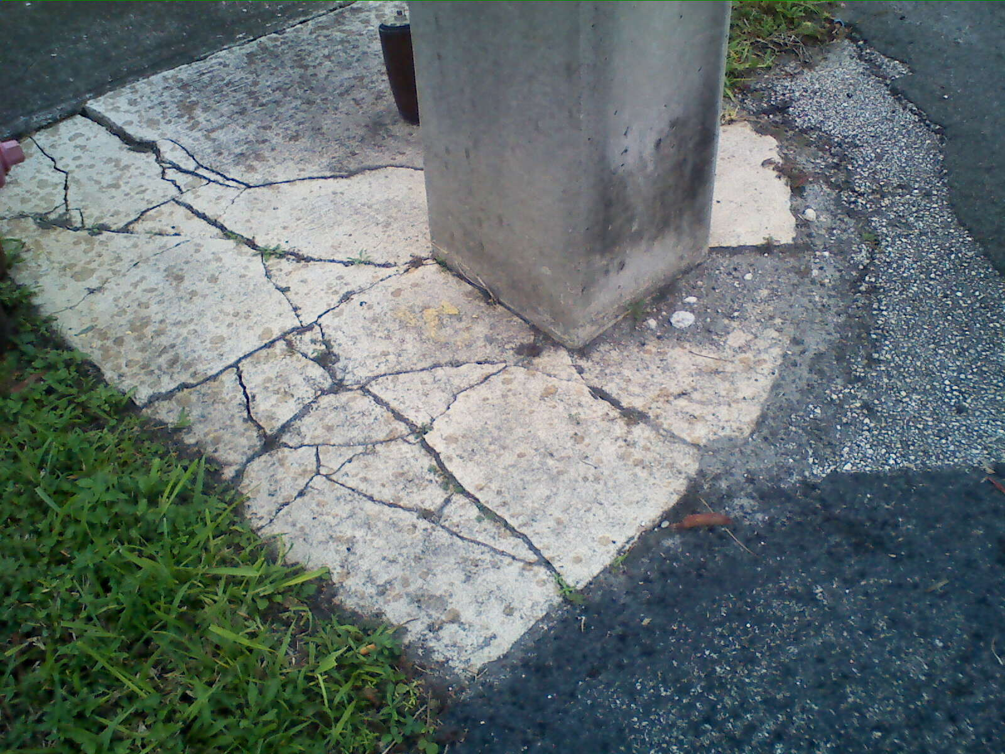
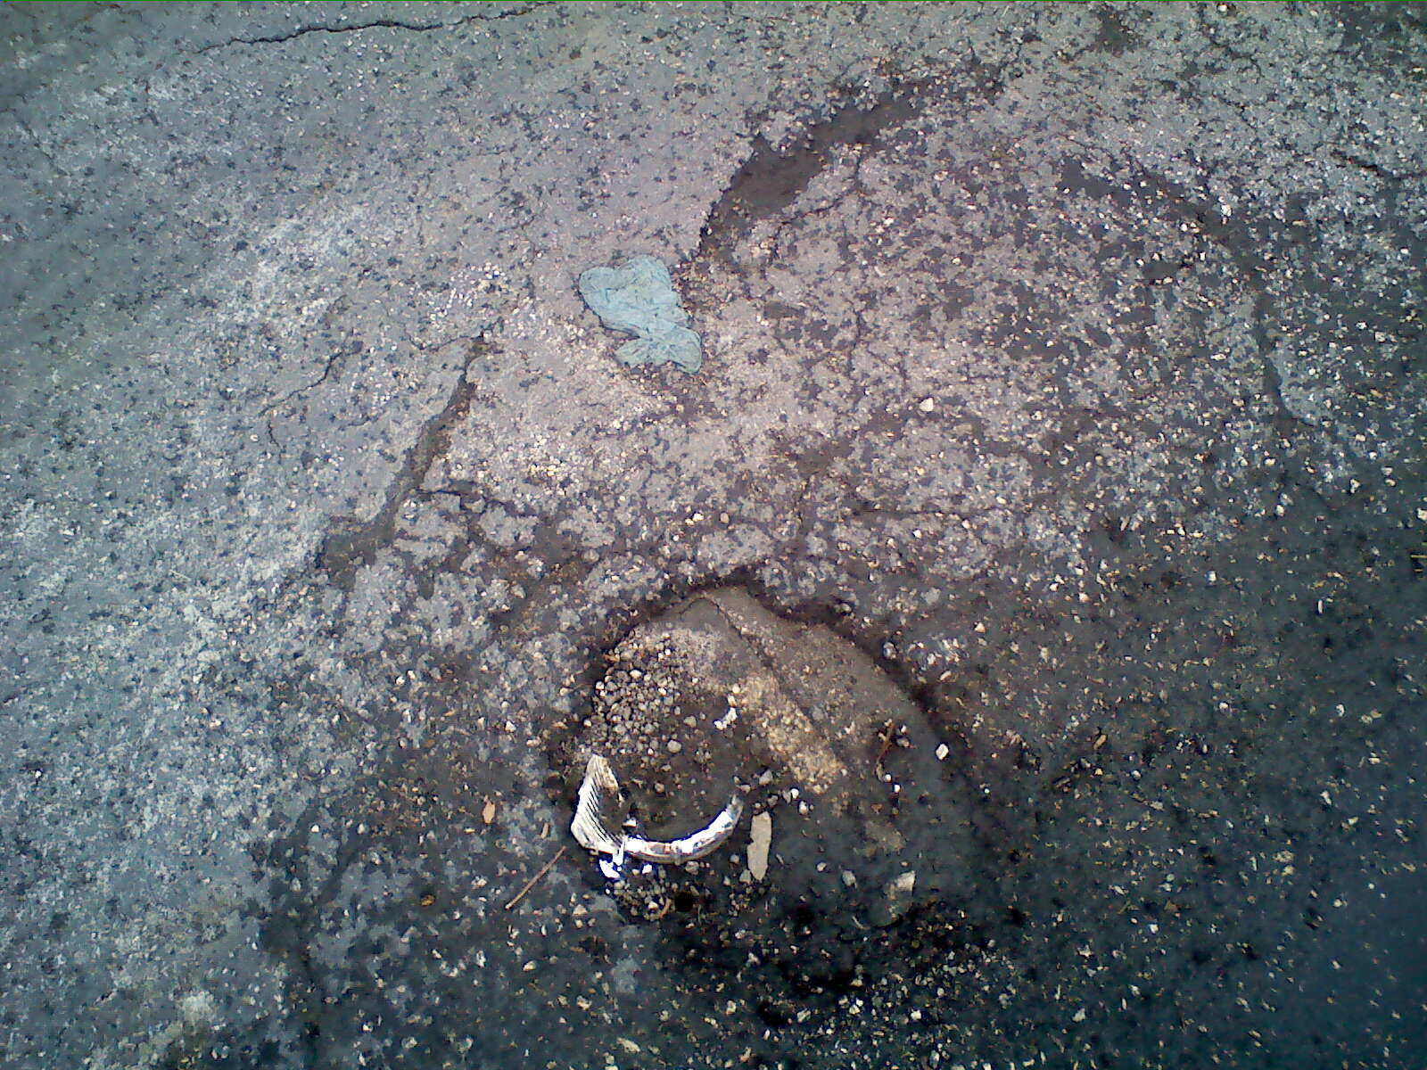

Slide 12
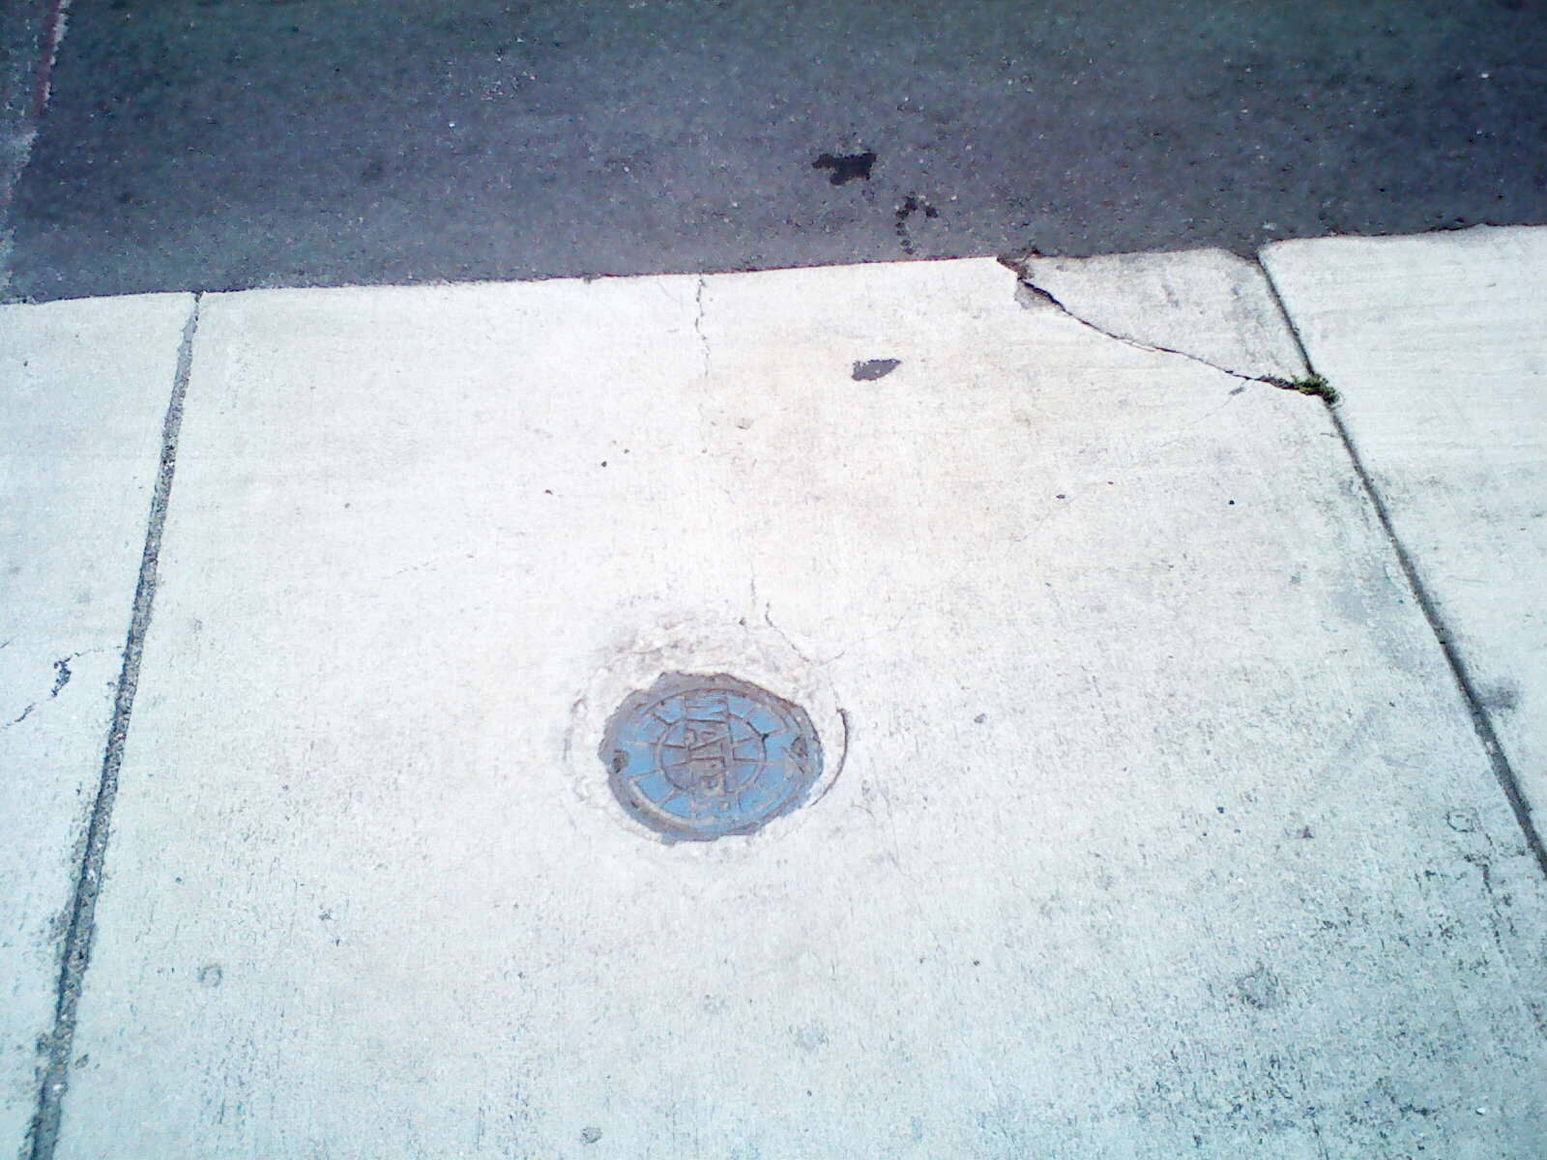
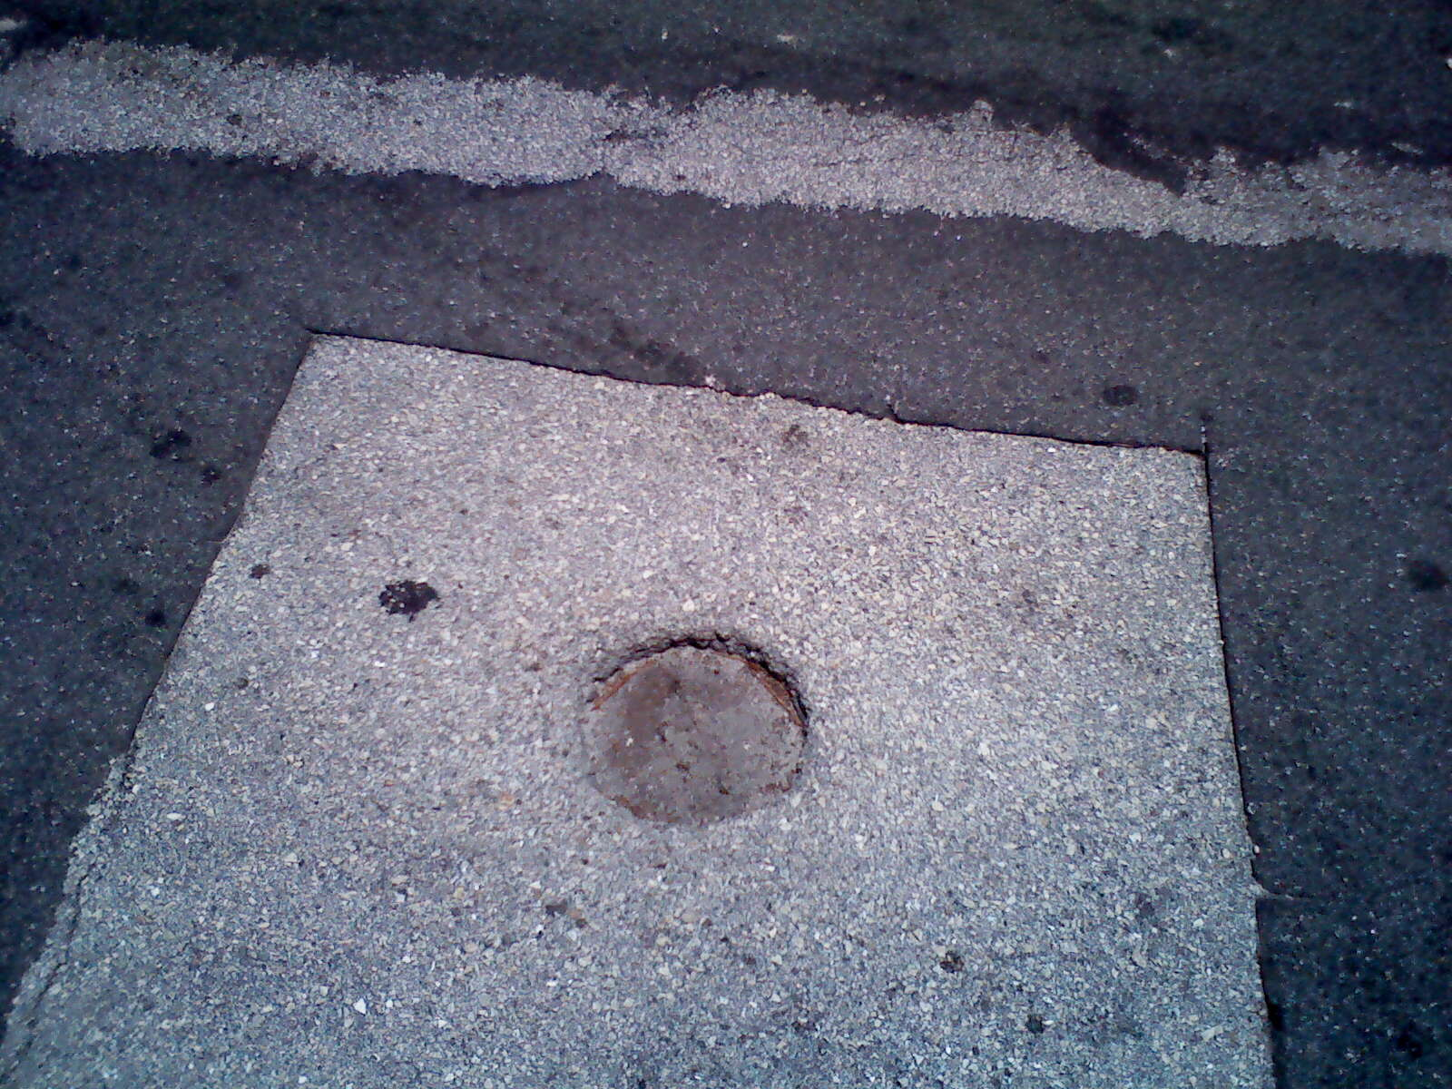
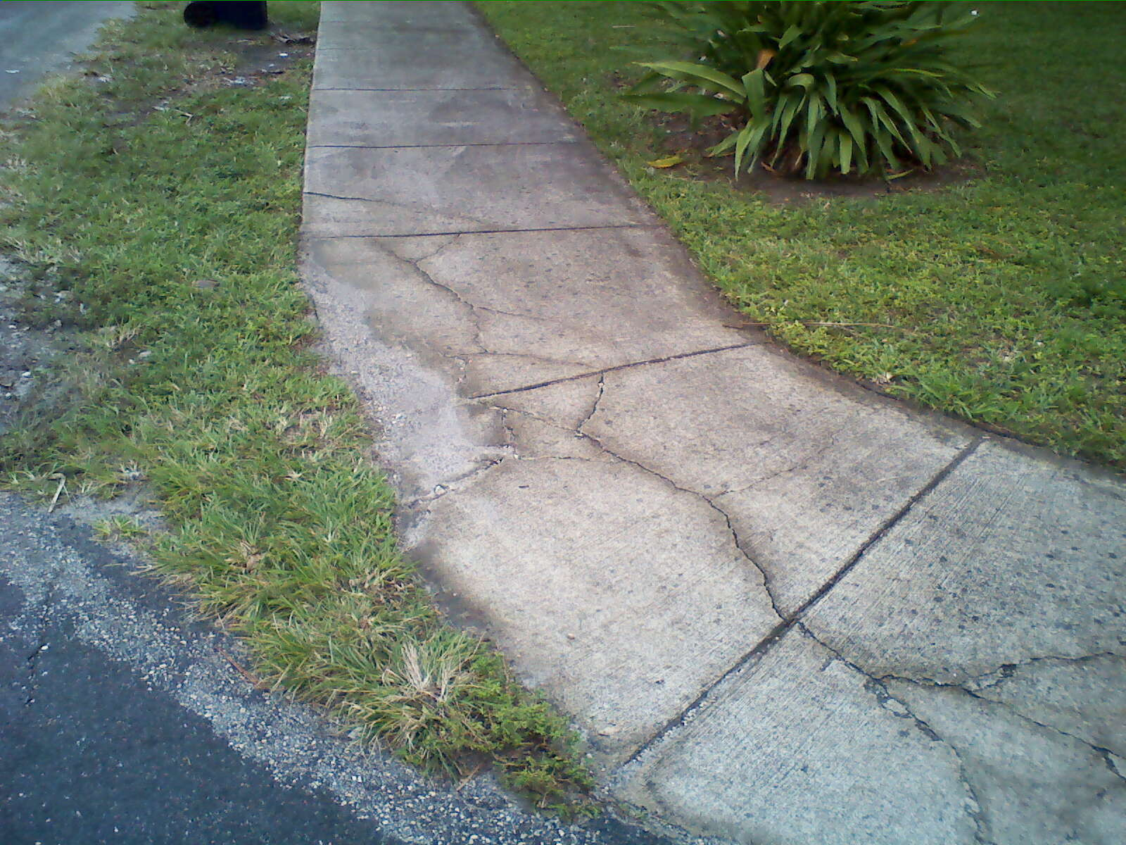

Slide 13
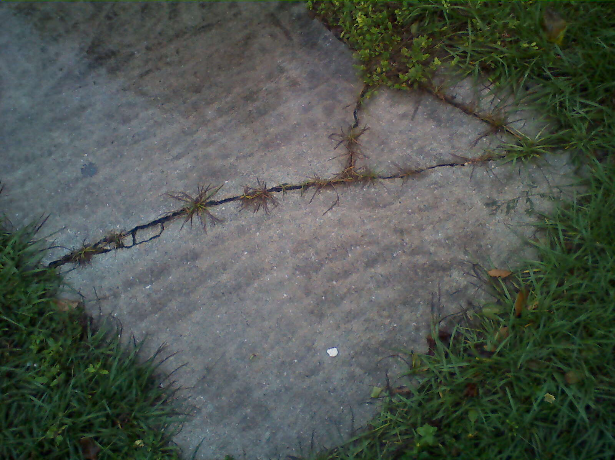
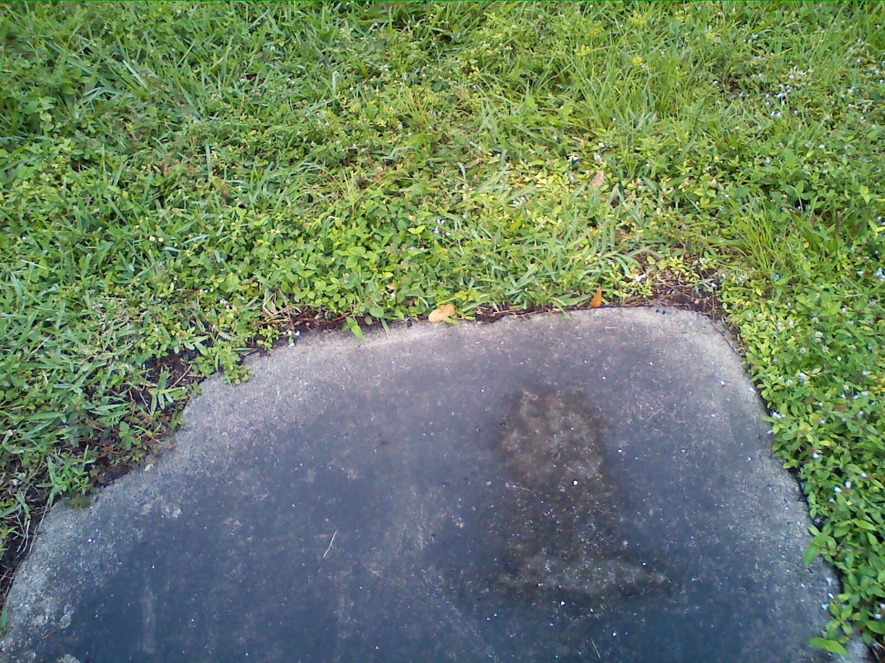

Slide 14
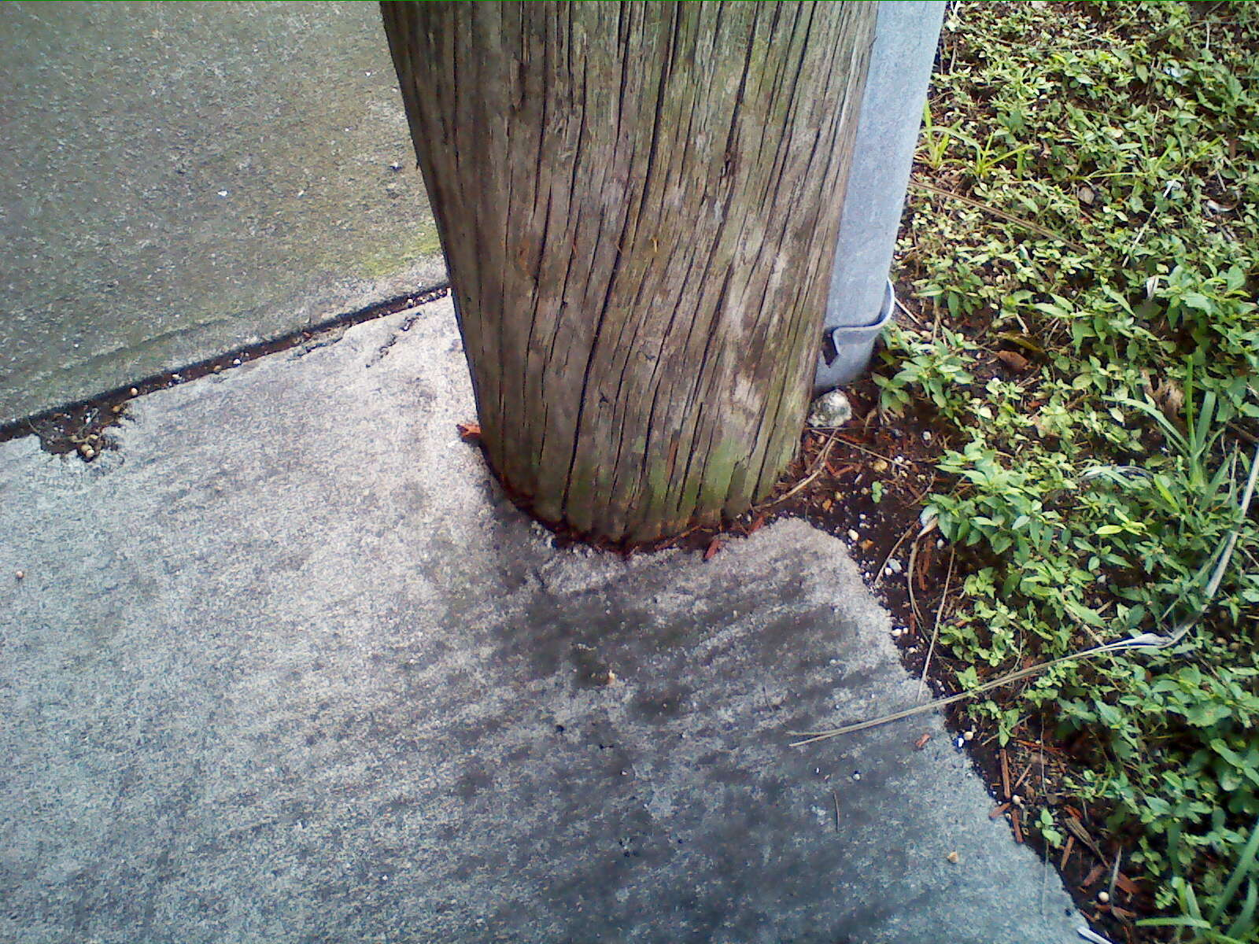
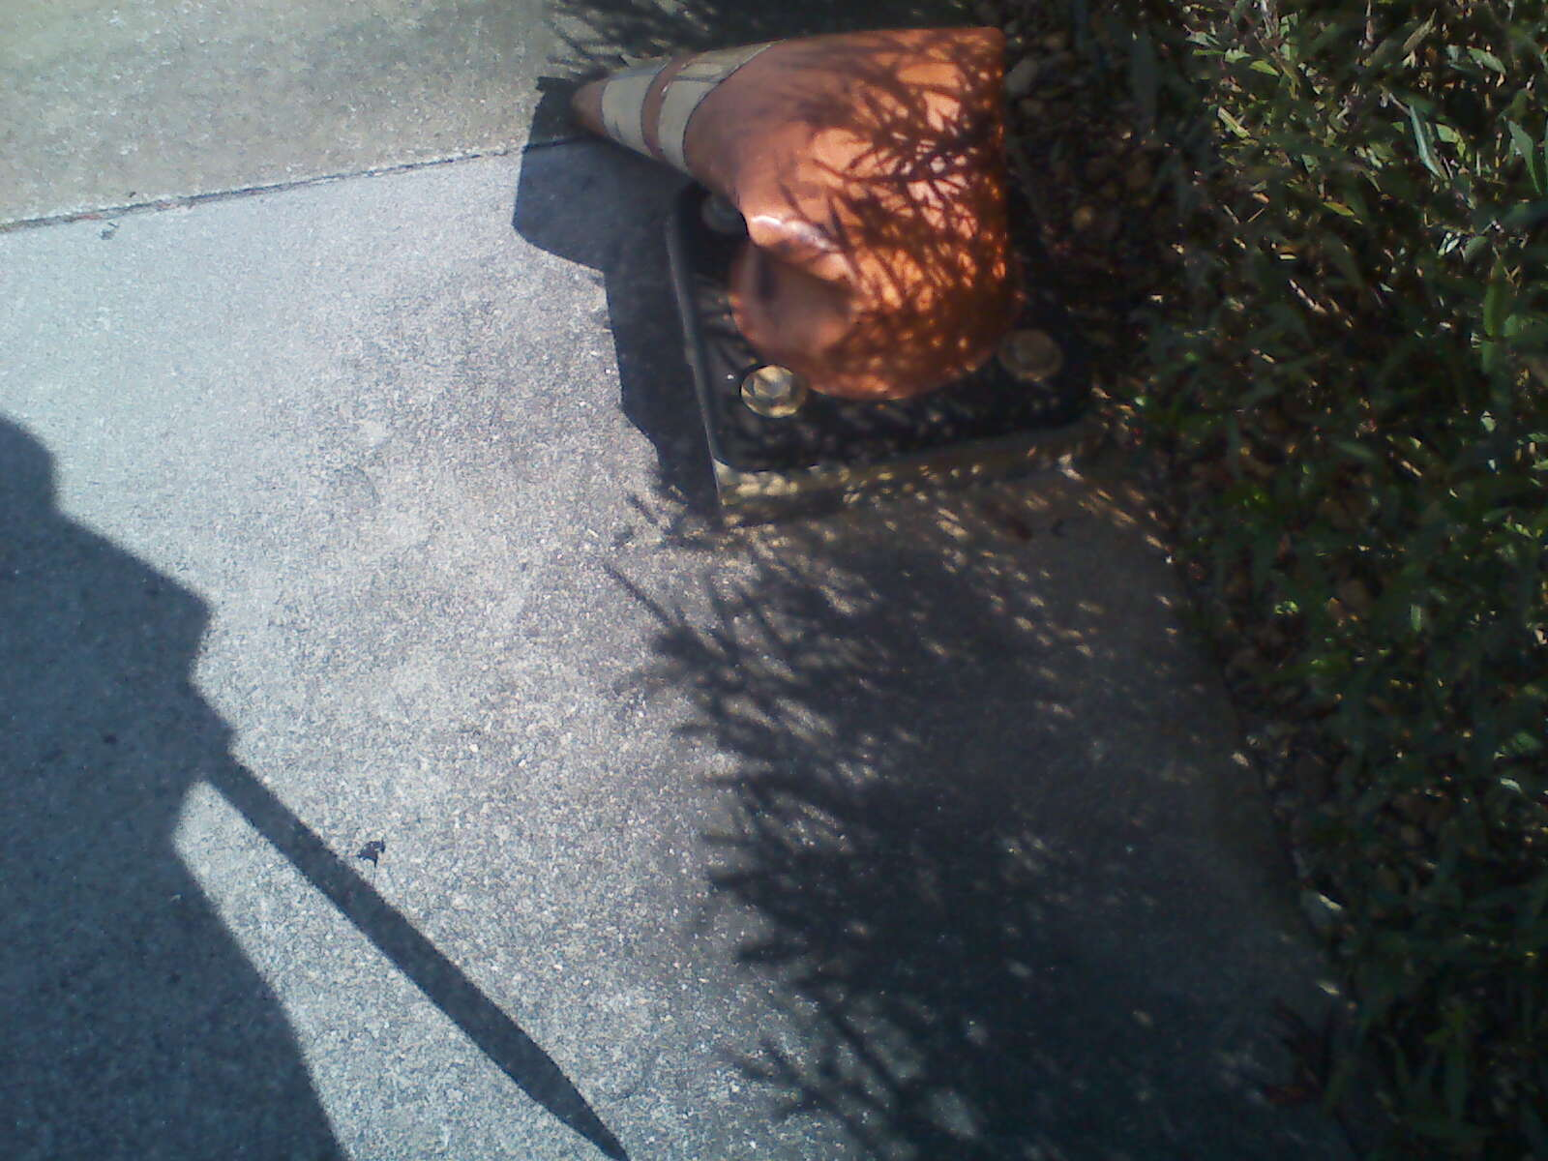
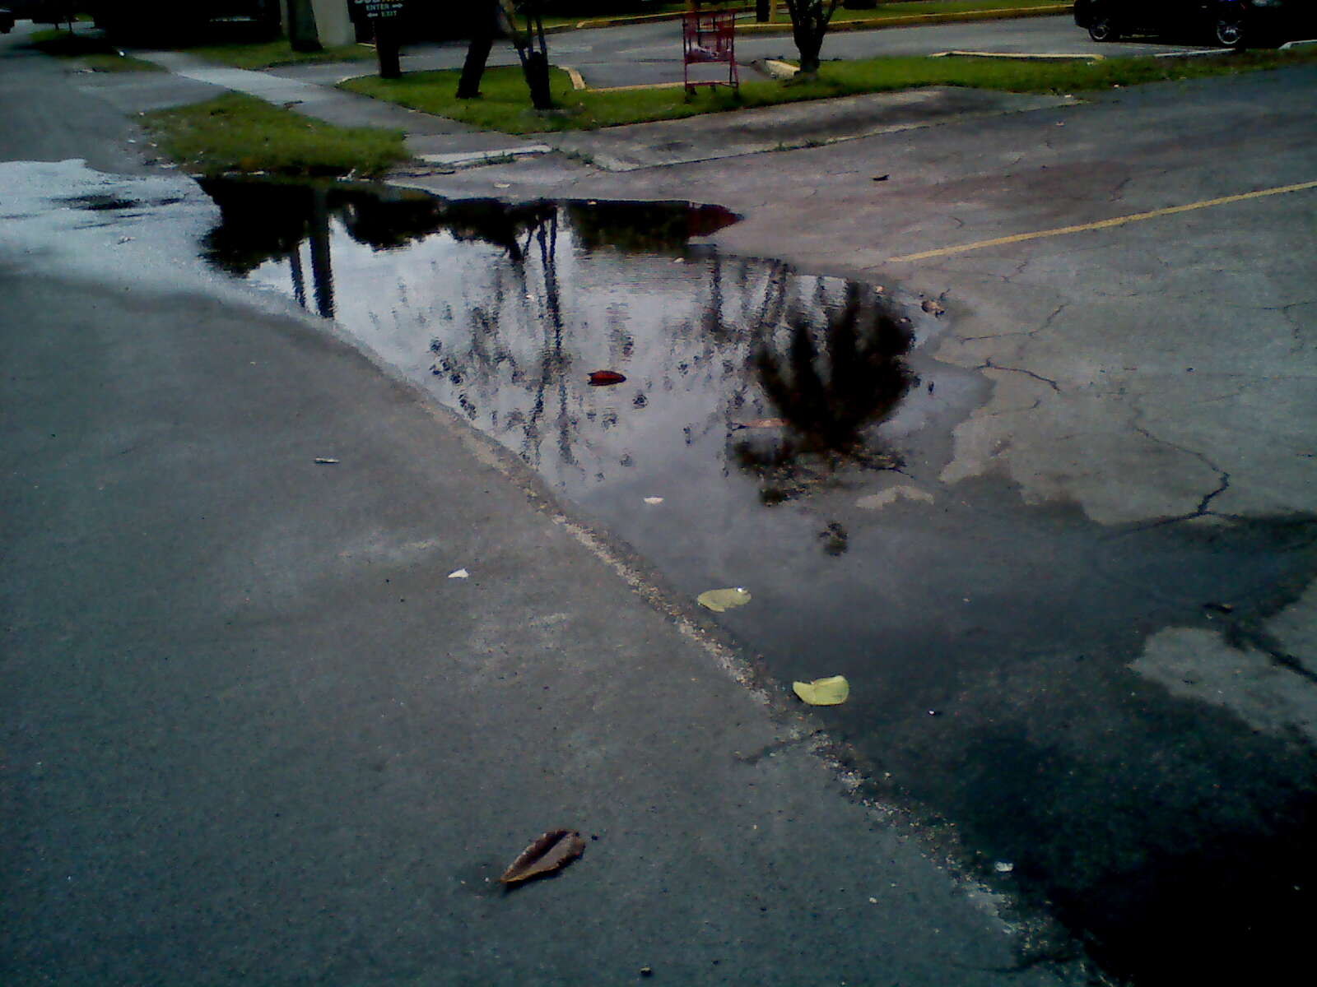
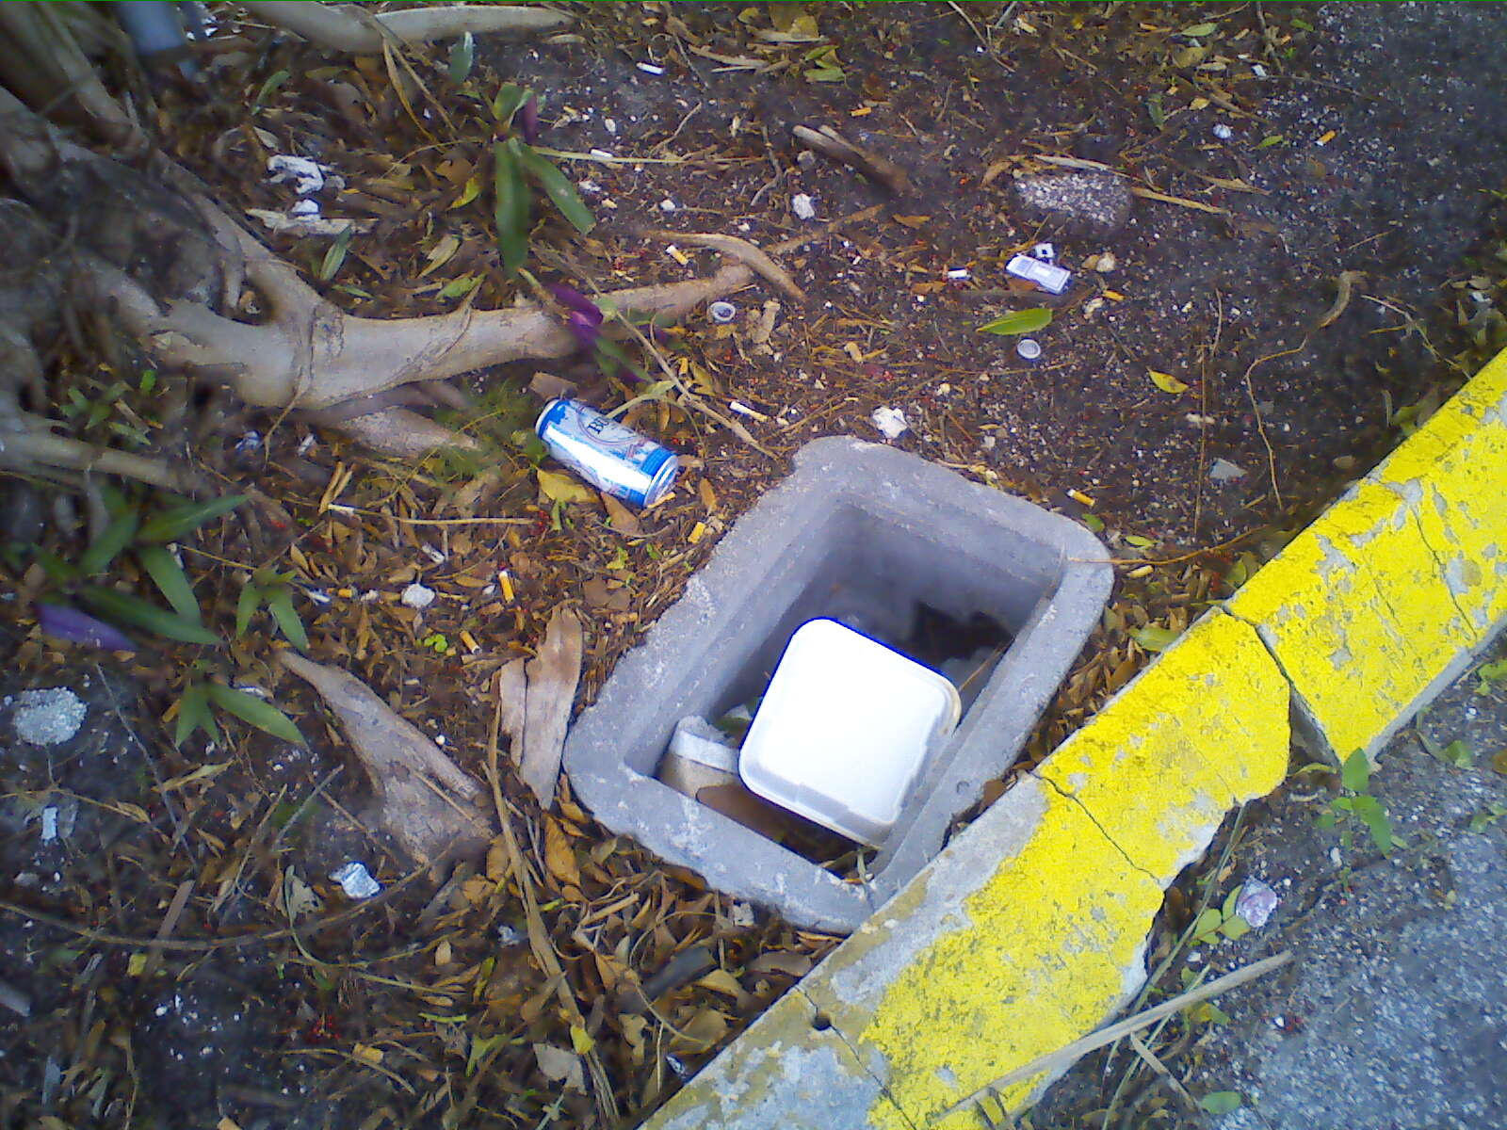
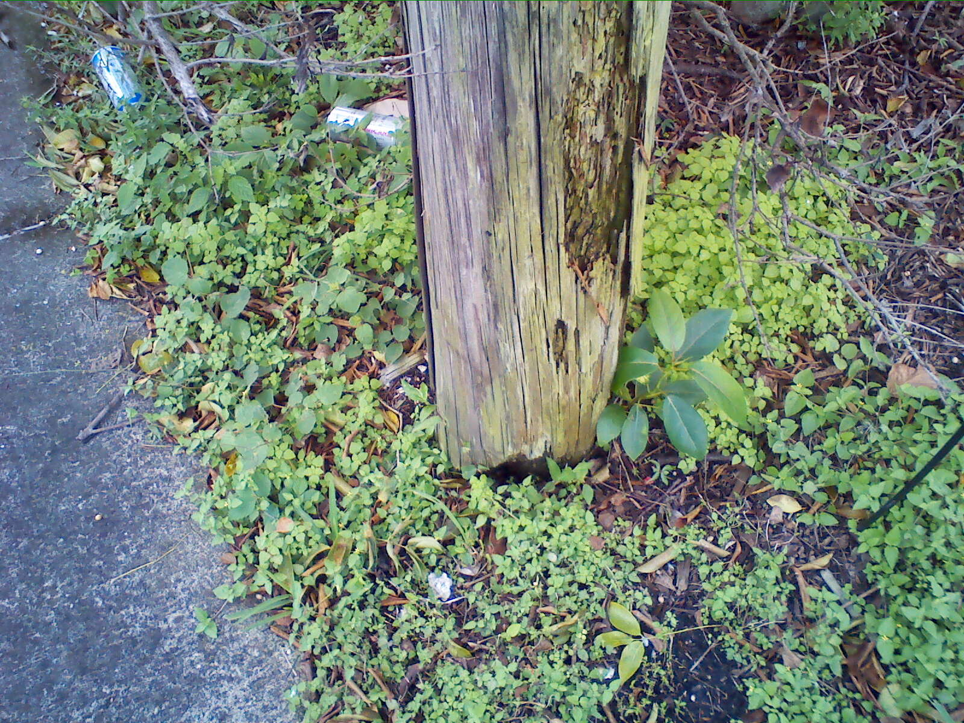
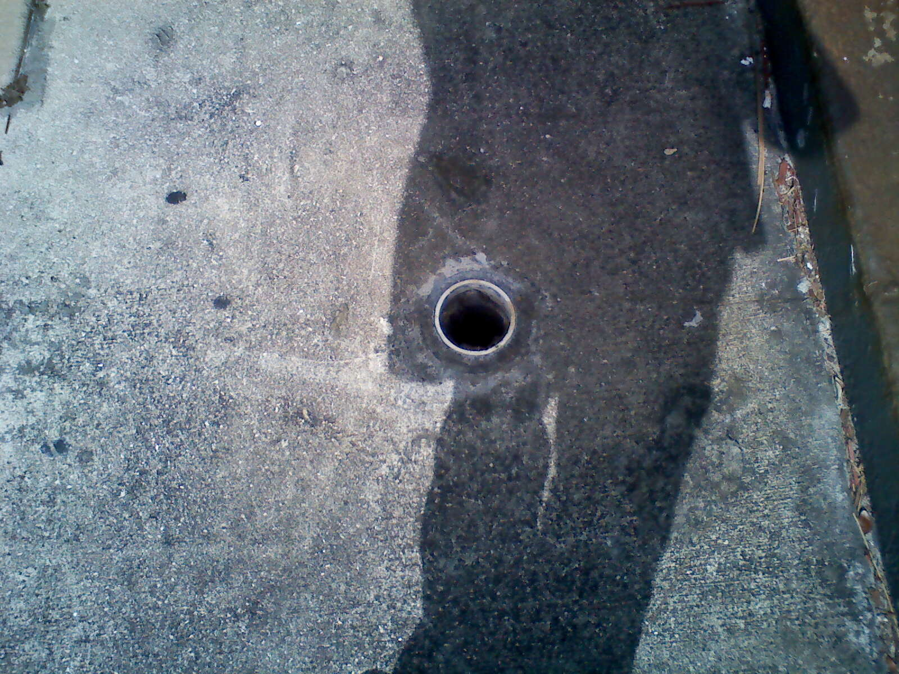

Slide 16
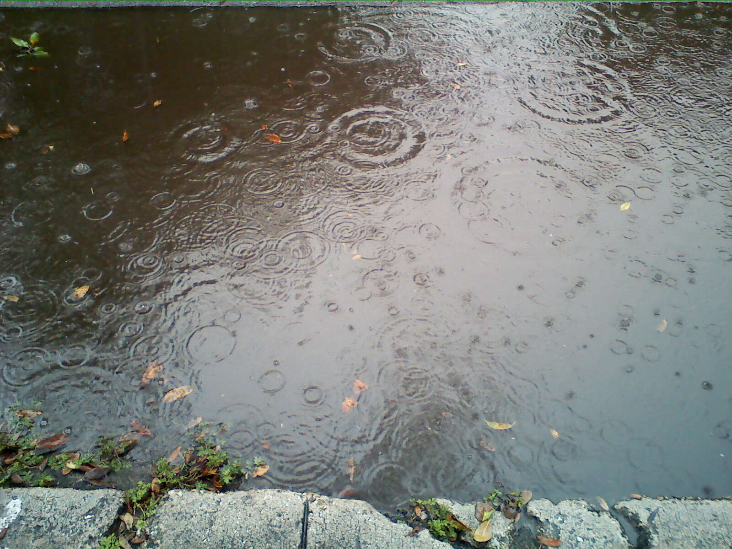

Slide 17
Process
Determine Goals & Objectives
Inventory of Assets
System Review & Assessment
AMP
Implementation
Quality Assurance
Proformance Feedback

Slide 18
Summary of Asset Condition
Category | Frequency | Percent
Good | 815 | 63%
Fair | 399 | 31%
Poor | 73 | 6%
Assessed Points – City of Dania Beach | 1287

Slide 19
Cost = $460,000
Some of this could be CDBG funds
CRA Funds
Storm water Funds
General Maintenance dollars

Slide 20
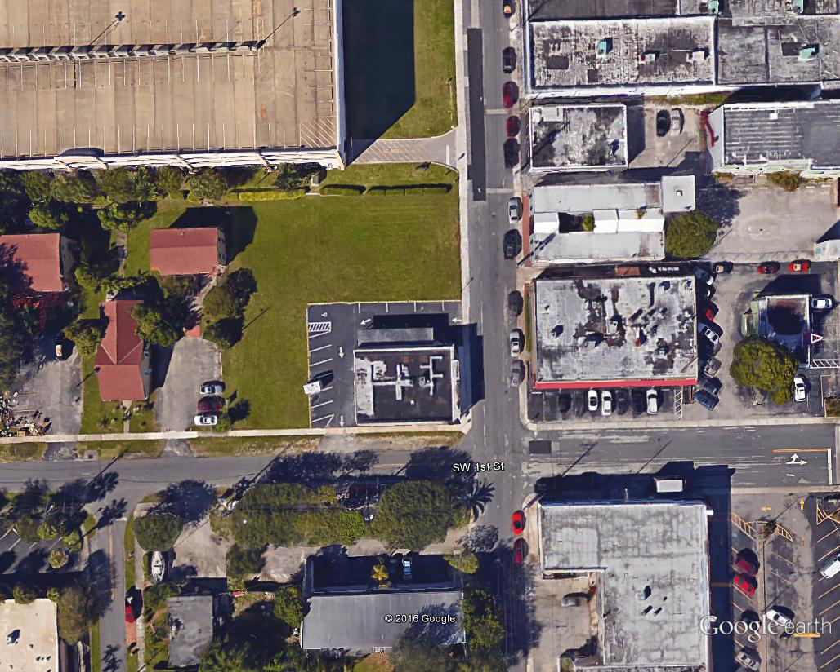

Blue= new sidewalks
White = new curbs
Green = Bioswale
Hatching = Pavers
Orange = crosswalk

Slide 21
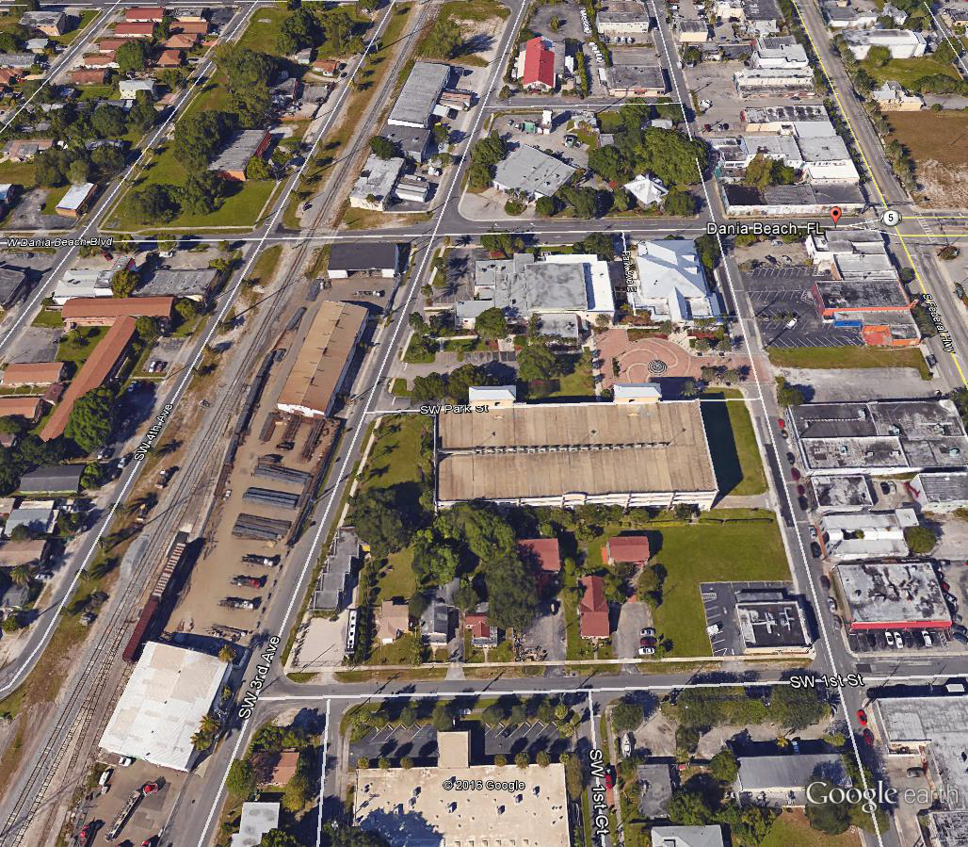

Slide 22
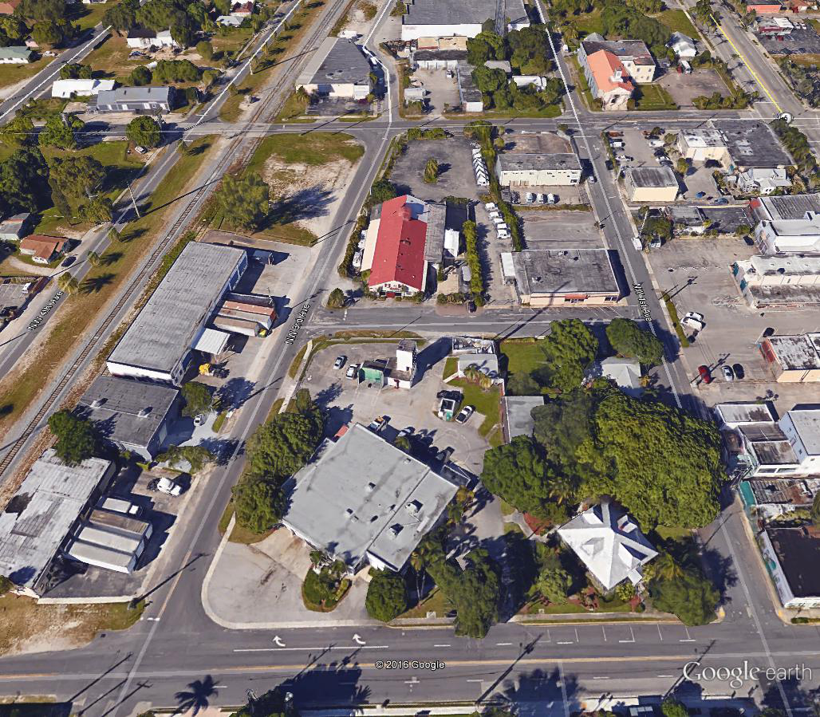

Slide 23
Improvements
$450,000 in maintenance needs today
Part of Oasis 9 = $80,000
Curbing - $60,000
Sidewalk upgrades - $70,000
Pavement - $75,000
Storm water - $30,000
Water Main - $ 35,000

Slide 24
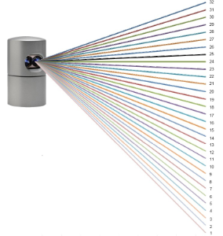
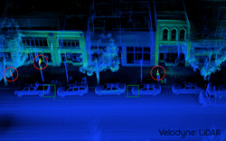
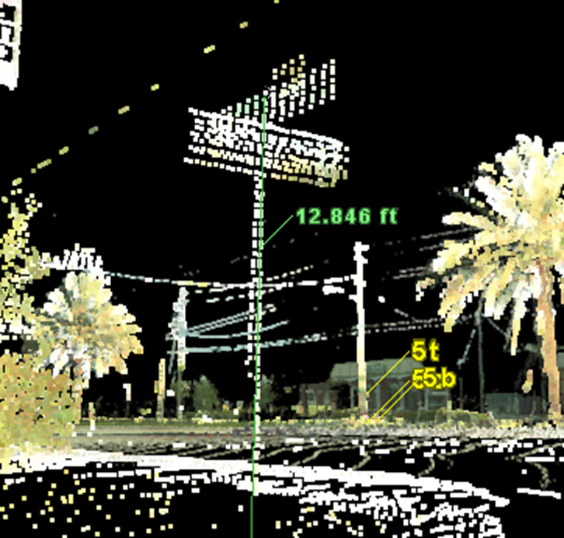
Experiment –
FAU: Mobile Mapping for the future

Slide 25

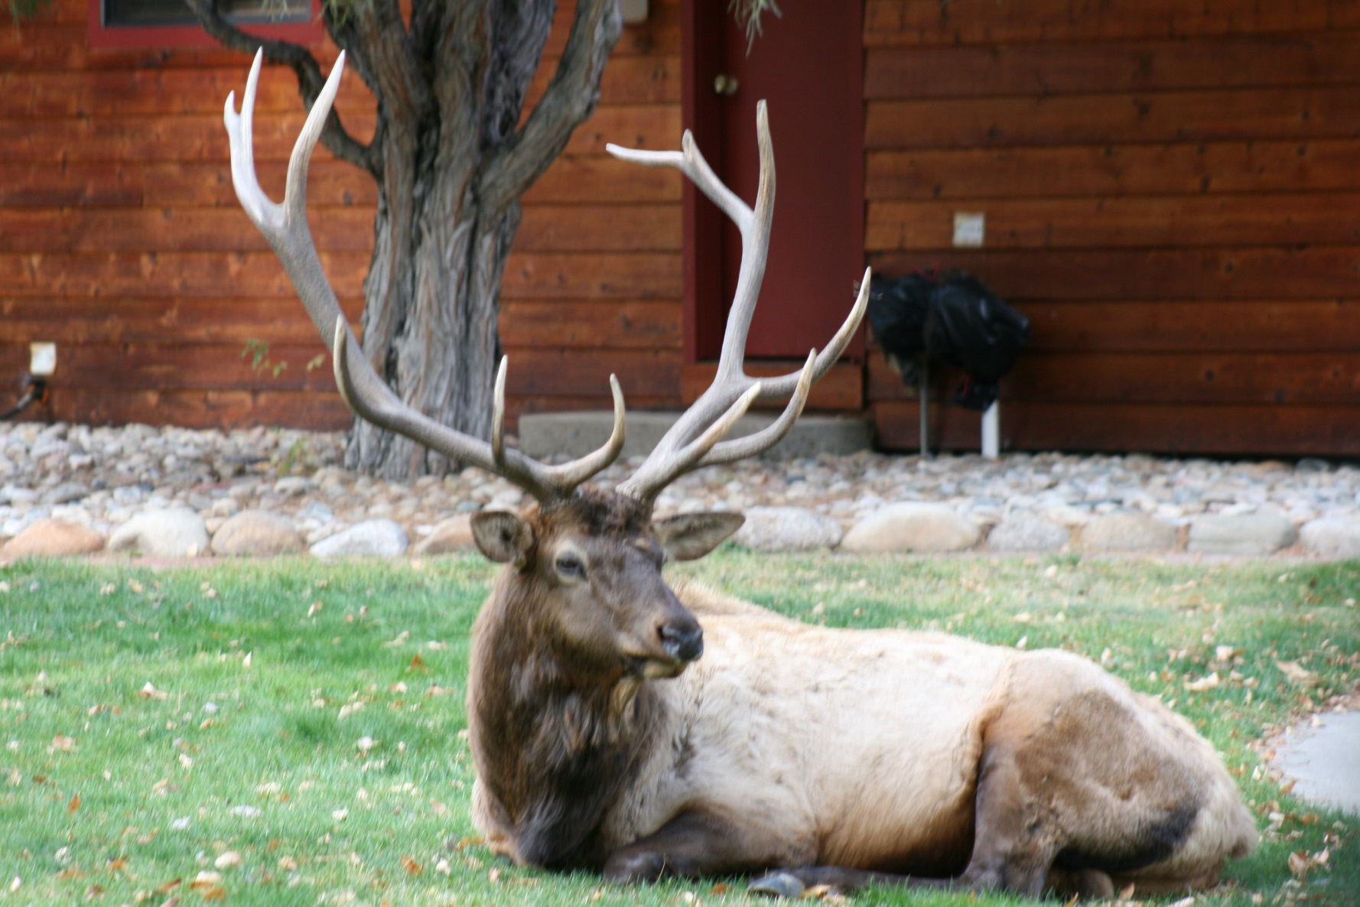
Questions?

